Slide 1

CHOOSE AURORA
Homebuyer Assistance Program
Updates
City of Aurora
Community Development Division
October 9th, 2025
Adam Grubbs
City of Aurora
Community Services Department
Community Development Division
Grubbsa@aurora.il.us / 630-256-3328
For Future Home Owners | City of Aurora, IL

Slide 2
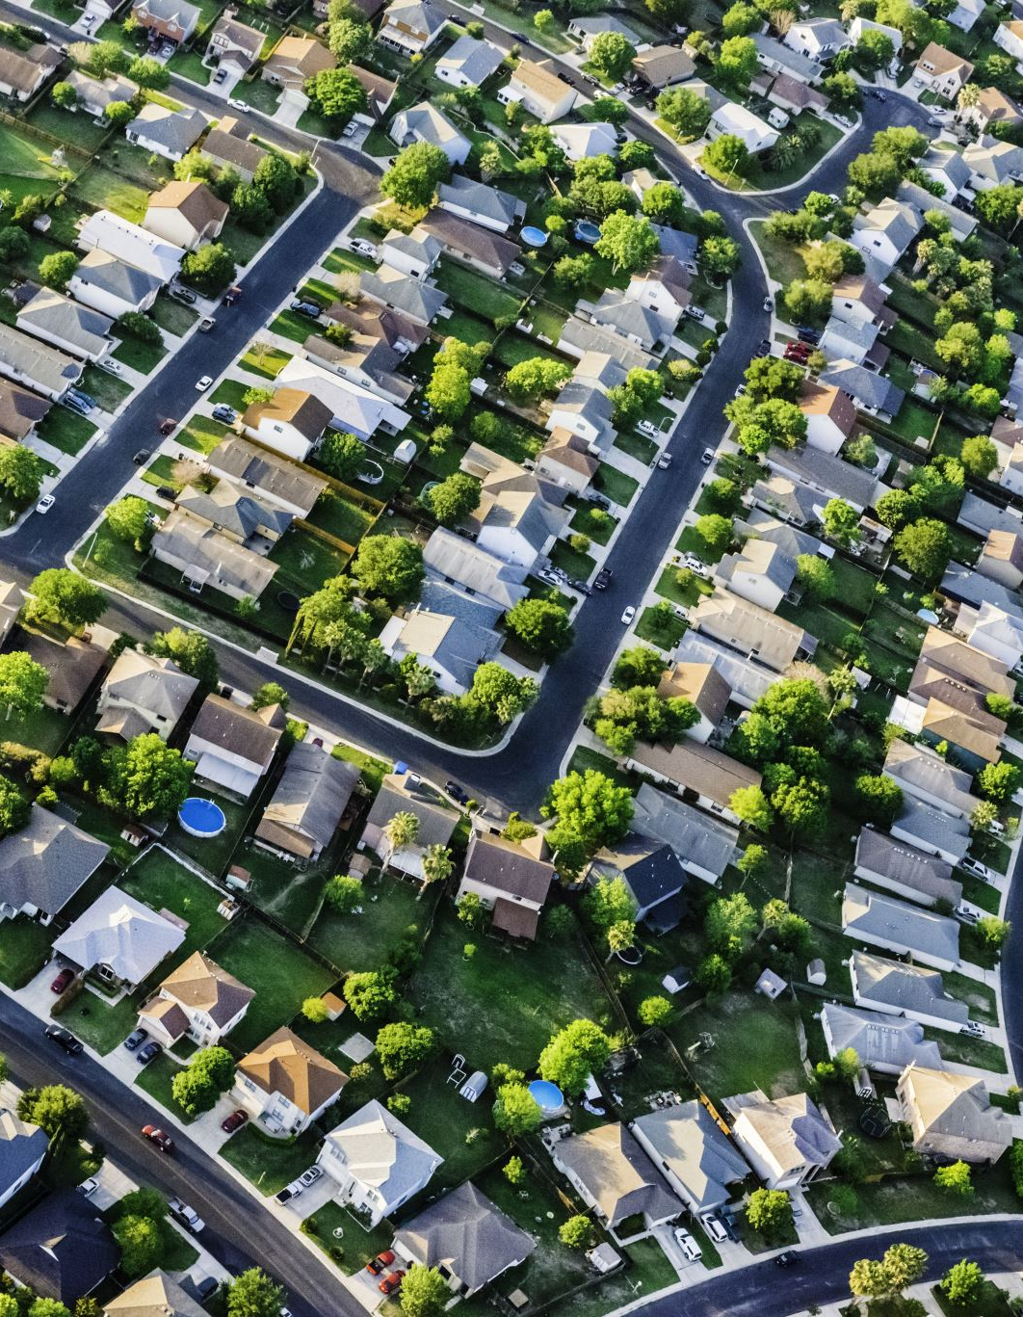
Choose Aurora Homebuyer Assistance Program
This program is based on need, by providing low to moderate income (30% AMI - 80% Area Medium Income (AMI)), and medium income (81% AMI - 120% AMI) households assistance to purchase a home.
Family of four at 80% AMI is $95,900.
Family of four at 120% AMI is $143,880.
The goal of this program is to help a household purchase a home that will give them an affordable monthly housing payment, and is safe and sanitary.

Slide 3
General Eligibility - Update
Old Program
Up to 80% AMI. Family of four is $95,900.
25% - 35% / 43% Debt to Income (DTI) ratios can go higher with compensating factors.
Safe & sanitary house – standard home inspection.
Other documents to determine eligibility property appraisal, conflict of interest form, pay stubs, bank statements, tax documents, visual assessment of deteriorated paint, etc.
New Program
Up to 120% AMI. Family of four is $143,880.
25% - 35% / 43% DTI can go higher with compensating factors.
Standard home inspection but a NSPIRE inspection (HUD Inspection)may be required (paid by the City).
Other documents to determine eligibility such as property appraisal, conflict of interest form, pay stubs, bank statements, tax documents, visual assessment of deteriorated paint, etc.
HUD- certified homebuyer counseling required. Housing Counseling | HUD.gov / U.S. Department of Housing and Urban Development (HUD)

Slide 4
Maximum Assistance - Update
Old Program
$3,000 or $5,000 based on location
Up to 80% AMI
Forgivable Lien
New Program
Up to $20,000 deferred loan based on DTI Ratios up to 120% AMI
Up to $5,000 closing costs grant
Up to $2,000 small repairs grant

Slide 5

Layering Assistance
Can be stacked with:
Banks down payment assistance
IHDA down payment assistance
Cannot be stacked with other counties that also run down payment assistance programs with HUD funding (Kane, DuPage, Kendall, or Will.)
Funds provided based on need. If applicant is at 30% on the front ratio of DTI without assistance. They are already paying an affordable payment.

Slide 6
Maximum Assistance by Income Eligibility (All members of the household over 18 years old)
Up to 80% AMI eligible for up to $27,000 in assistance. ($20,000 deferred loan, $5,000 closing costs grant, $2,000 small repairs grant)
Between 80% AMI - 120% AMI eligible for up to $22,000 in assistance. ($20,000 deferred loan, $2,000 small repairs grant)
80% AMI | 1 | 2 | 3 | 4 | 5
 | $67,150 | $76,750 | $86,350 | $95,900 | $103,600
81% - 120% AMI | 1 | 2 | 3 | 4 | 5
 | $100,800 | $115,200 | $129,600 | $143,880 | $167,860

Slide 7
Deferred Down Payment Assistance Break Down – up to $20,000
Deferred Loan for 30% AMI - 80% AMI - Federal funding source.
NSPIRE home inspection required.
Homebuyer Counseling Required.
25% - 35% / 43% DTI. With compensating factors can go higher.
Maximum purchase prices.
Deferred Loan for 80% AMI - 120% AMI - City funding source.
Standard home inspection.
Homebuyer Counseling Required.
25% - 35% / 43% DTI. With compensating factors can go higher.
No maximum purchase prices.
Can be combined with Closing Costs Grant and Home Repairs Grant.
Can be combined with Home Repairs Grant.
Total Funds Available = $600,000

Slide 8

Closing Costs Assistance Program - $5,000
If combined with Deferred loan 30% AMI - 80% AMI, similar requirements, if not:
Regular home inspection
30% AMI - 80% AMI income limit. For a family of four $95,900.
25% - 35% / 43% DTI. With compensating factors can go higher.
Maximum purchase prices by county.
Total funds available - $50,000.
Can be combined with 30% AMI - 80% AMI deferred loan and Home Repairs Grant.

Slide 9

Small Repairs Grant - $2,000
Total available funding - $20,000
Can ONLY be combined with homebuyer assistance.
How it works
This program will assist homebuyers with repairing safety related concerns in the property to be purchased prior to closing.
Up to $2,000.
Items that pose fire hazard, electrocution hazard, sanitary hazard, flood hazards, and other safety and sanitary risks.
This will be based on reimbursement.

Slide 10

Approval Process – 3-4 Weeks
Pre-application submittal
Pre-application review
Application submittal
Application review
Follow up for additional required documents takes the longest amount of time for a file to be approved. When submitting the application, ensure to submit all required documents for file to be approved as quickly as possible.
Homebuyer signs agreement, W9, income certification
Purchasing Division signs agreement
Wire Instructions from Mortgage Lender
Signed agreement, wire instructions, and other supporting approval documents sent to the Accounting Division to set up a wire transfer for the closing.
At closing, homebuyer signs the city’s mortgage and note.
After closing, the city needs a copy of the Final Closing disclosure and to be named on the Home Owner’s Insurance and receive a copy of this.

Slide 11
What if the required repairs exceed $2,000???
Unfortunately, they will not qualify for the Choose Aurora Homebuyer Assistance Program. A large component of this program is assisting homebuyers to purchase a safe and sanitary home.
However, if they income qualify for the Choose Aurora Program, they will most likely qualify for the Safety First Program, funded by the City and managed by The Neighbor Project, Up to $15,000 in repair assistance
630-906-9400; Brett Campbell brett@neighborproject.us.

Slide 12
Maximum Purchase Price - Update
Old Program
New Program
Maximum Purchase prices by county (DuPage, Kane, Kendall, Will).
Maximum purchase prices by county (DuPage, Kane, Kendall, Will) for 80% AMI
No maximum purchase price from 81% AMI - 120% AMI.
Existing Homes – Purchase Price limit | 1 Unit | 2 Unit | 3 Unit | 4 unit
Maximum HOME Value
DuPage County | $361,000 | $462,000 | $560,000 | $693,000
Kane County | $297,000 | $380,000 | $460,000 | $570,000
Will County | $297,000 | $380,000 | $460,000 | $570,000
Kendall County | $285,000 | $365,000 | $442,000 | $547,000
New Homes – Purchase Price limit | 1 Unit | 2 Unit | 3 Unit | 4 unit
Maximum HOME Value
DuPage County | $361,000 | $462,000 | $560,000 | $693,000
Kane County | $357,000 | $457,000 | $554,000 | $686,000
Will County | $356,000 | $456,000 | $552,000 | $684,000
Kendall County | $304,000 | $389,000 | $471,000 | $584,000

Slide 13
Debt to Income Ratios – No Change
Acceptable debt to income ratio for this program is 25%-35%/43%.
Why?
This is a DTI that the City considers to be affordable.
HUD’s definition of affordable housing is a household paying 30% of their gross income towards a housing payment, including utilities.
With certain compensating factors, the program can go up to 40%/50%.

Slide 14
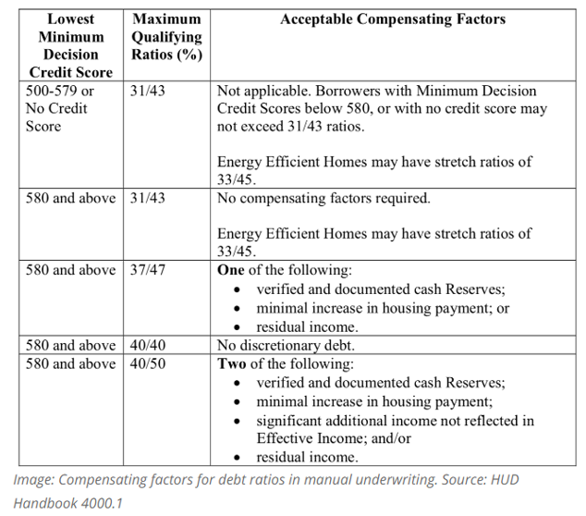
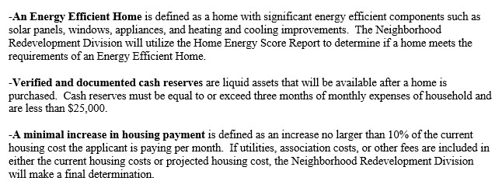
Compensating Factors

Slide 15
First Time Home Buyer - Update
Old Program
First time homebuyers buying a home in Aurora.
New Program
All homebuyers buying a home in Aurora.

Slide 16
Homebuyer Education
Old Program
New Program
For homebuyers up to 120% AMI or under, HUD-certified housing counseling required.
Any HUD-certified housing counselor can be used; however, the City of Aurora will pay if it occurs through The Neighbor Project & Xilin Association
The Neighbor Project: 630-609-9400
Xilin Association: 630-701-2983; Contact - Xilin Association
Homebuyers must provide HUD certified housing counselor certificate to show successful completion.
Recommended, not required

Slide 17
Eligible Homes – No Change
Existing homes
New Construction
Single family homes (condos, townhomes, etc.)
Properties 1 unit
Rental properties are still not allowed at this time.

Slide 18

Mortgage Type
30-Year Fixed FHA or Conventional Mortgage

Slide 19

Minimum Contribution – No change
$1,000 Minimum contribution.
Earnest money

Slide 20
Home Inspection Requirements
Old Program
Regular home inspection
New Program
30 % AMI - 80% AMI deferred loan – NSPIRE HOME Inspection
The City will pay for the NSPIRE Inspection to be completed. Homebuyers will be responsible to pay for regular home inspections.
80% AMI - 120% AMI deferred loan – regular home inspection
Closing costs grant – regular home inspection

Slide 21
Owner Occupancy – No Change
The homebuyer must occupy the home as their primary residence. They cannot rent it. There will be no partial forgiveness, full payback is required if the homebuyer breaks the homebuyer agreement. The property must remain their primary residence.

Slide 22
Full List of Required Documents
Prior to closing:
Loan pre-qualification letter.
Executed Real Estate Purchase Agreement.
Two months of paystubs, checking statements, savings statements for everyone over 18 in the household.
1040.
W2.
Lender Mortgage Loan Application.
Property Appraisal.
Home Inspection (NSPIRE).
Visual Assessment for Deteriorated Paint.
Conflict of Interest Form.
Photo I.D.
Signed Agreement.
Note.
Mortgage.
Signed Income Certification.
W9.
After closing
Final Closing Disclosure.
City of Aurora named on Home Owner Insurance.

Slide 23

Questions?
Thank you for attending!
Adam Grubbs
City of Aurora
Community Services Department
Community Development Division
Grubbsa@aurora.il.us / 630-256-3328
For Future Home Owners | City of Aurora, IL

