Slide 1
2027
CITY OF AURORA PROPOSED BUDGET

Slide 2
OVERVIEW
REVIEW OF THE PROPOSED 2027 DRAFT BUDGET
  BUDGET HIGHLIGHTS
  GENERAL FUND
FINAL STEPS IN THE PROCESS

Slide 3
2027 BUDGET HIGHLIGHTS
$577.3M IN REVENUE (BEFORE CARRYOVERS)
$603.7M IN EXPENDITURES (BEFORE CARRYOVERS)
$26.4M BUDGETED REVENUES AND FINANCING SOURCES FROM 2026 AND PRIOR
  TIMING DIFFERENCES IN EXPENSES
    DEBT PROCEEDS

Slide 4
2027 BUDGET HIGHLIGHTS
LEVY INCREASING TO OFFSET PUBLIC SAFETY PENSION COSTS
  PUBLIC SAFETY PENSION LEVIES ARE STATUTORILY REQUIRED MINIMUM AMOUNT
    POLICE = 7.59% ($1,745,808 INCREASE)
    FIRE= 7.94% ($1,307,151 INCREASE)
Notes:
2026 as a reference Police increased 2.4 fire 16.5

Slide 5
Notes:
2012 Police Pension $8.6
2012 fire $7.3
2026 $24.7 police
2026 $17.8 fire

Slide 6
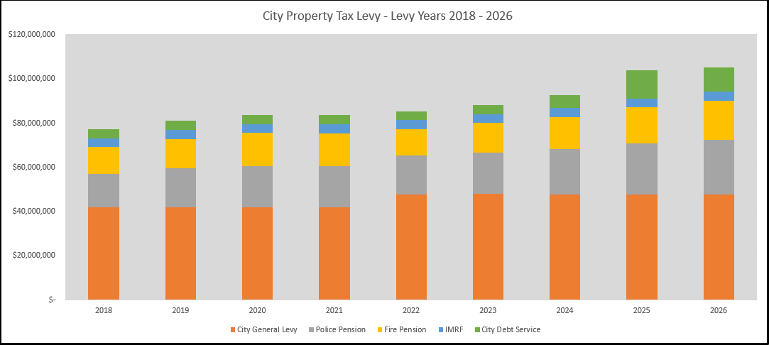
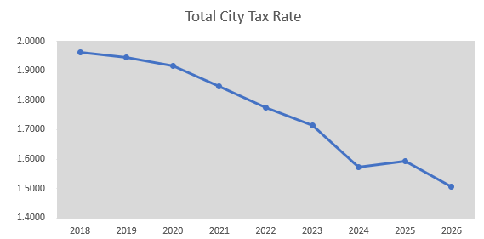
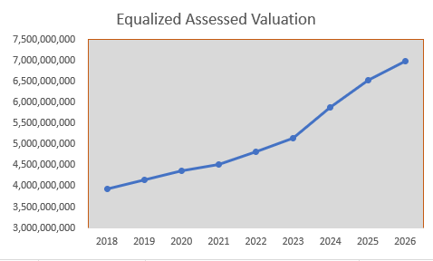

Slide 7
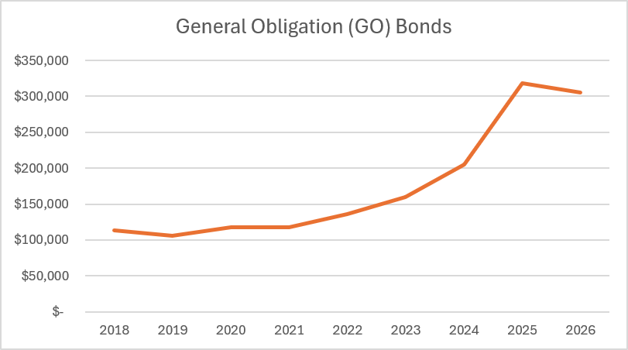
CITY GENERAL OBLIGATION (GO) BONDS
IN MILLIONS
Notes:
2018 $113,080
2019 $106,330
2020 $117,305
2021 $117,995
2022 $136,355
2023 $159,650
2024 $205,180
2025 $318,570
2026 $305,295

Slide 8
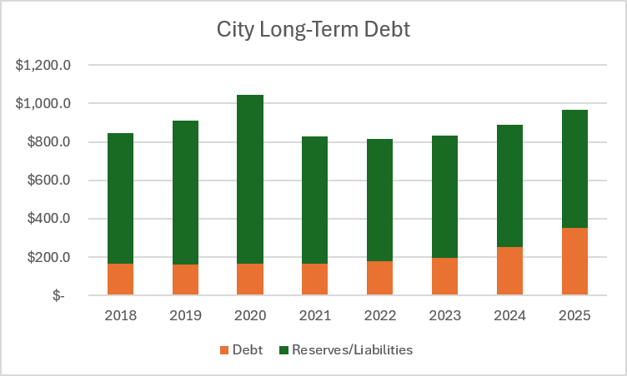
CITY LONG-TERM DEBT OUTSTANDING
(in millions)
Notes:
Debt Reserves/Liab
2018 $ 163.8 $ 683.60
2019 $ 160.0 $ 752.0
2020 $ 166.9 $ 877.5
2021 $ 164.3 $ 664.60
2022 $ 178.8 $ 635.40
2023 $ 197.5 $ 636.0
2024 $ 253.1 $ 637.40
2025 $ 352.1 $ 612.80

Slide 9
GENERAL FUND REVENUES
92% OF GENERAL FUND REVENUES COME FROM 9 MAIN SOURCES
  PROPERTY TAXES
  STATE SALES TAX
  HOME RULE SALES TAX
  FOOD, BEVERAGE, & LIQUOR TAXES
  UTILITY TAXES
  INCOME TAXES
  PERSONAL PROPERTY REPLACEMENT TAXES
  BUILDING PERMITS
  FIRE SERVICES
Notes:
Property Taxes $95,154,400
State Sales Tax $46,331,000
Home Rule Sales Tax $21,883,000
Food, Beverage, and Liquor Taxes $9,586,000
Utility Taxes $14,868,000
Income Taxes $32,905,000
State Personal Property Replacement Taxes $6,695,000
Building Permits $5,306,100
Fire Services Revenue $11,873,201
Other $20,202,515
$264,804,216

Slide 10
2027 PRIORITIES
CONTINUING THE WORK OF FINANCIAL STABILITY
PROTECTING AND STRENGTHENING OUR WATER SYSTEM
  REPLACING LEAD SERVICE LINES
CATCHING UP ON INFRASTRUCTURE
  NEIGHBORHOOD STREET IMPROVEMENTS
  ORCHARD SOUND WALL
PRESERVING PUBLIC SAFETY
BUILDING A STRONGER AND MORE SUSTAINABLE LOCAL ECONOMY

Slide 11
PAST CONTRIBUTING FACTORS-BALANCING THE GENERAL FUND
IN THE PAST FEW YEARS, THE MAYOR’S OFFICE MOVED FUNDS AROUND TO MEET THE DEFICIT IN THE GENERAL FUND
  2023 $7,320,000
  2024 $8,280,000
  2025 $20,374,000
FUNDS THAT WERE FUNDED AT A LOWER LEVEL OR NOT AT ALL
  HOME RULE SALES TAX ALLOCATION FROM CIP
  CONTRIBUTION TO EMPLOYEE COMPENSATED BENEFITS FUND
  CONTRIBUTION TO EMPLOYEE HEALTH INSURANCE FUND
  CONTRIBUTION TO RETIREE HEALTH INSURANCE FUND
  CONTRIBUTION TO PROPERTY AND CASUALTY FUND
  CAPITAL IMPROVEMENT FUND

Slide 12
WHAT WAS DONE FOR THE 2026 DEFICIT
ELIMINATION OF COMMUNITY AFFAIRS DEPARTMENT
REDUCTION IN SOFTWARE USE
139 STAFF REDUCTION
  SOME THROUGH ATTRITION
PUBLIC FACILITIES MOVED TO PUBLIC WORKS
CLERK & SUSTAINABILITY MOVED TO EXECUTIVE
WORKED TO REPLENISH INTERNAL SERVICE FUND RESERVES

Slide 13
2027 BUDGET HIGHLIGHTS
    GENERAL FUND
    2027
    REVENUES $264,804,216
    ADD/(SUBTRACT): LATE CHANGES ____________
    TOTAL REVENUES $264,804,216
    EXPENDITURES $269,148,108
    ADD/(SUBTRACT): LATE CHANGES ____________
    TOTAL EXPENDITURES $269,148,108
    SURPLUS/(DEFICIT) ($ 4,343,892)

Slide 14
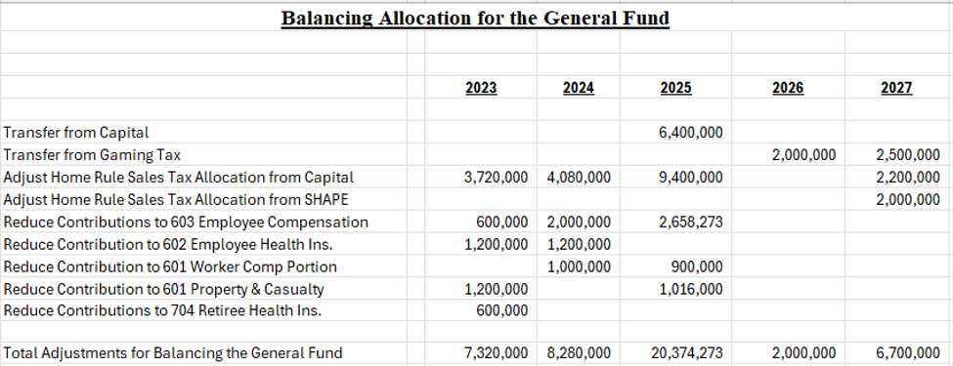

Slide 15
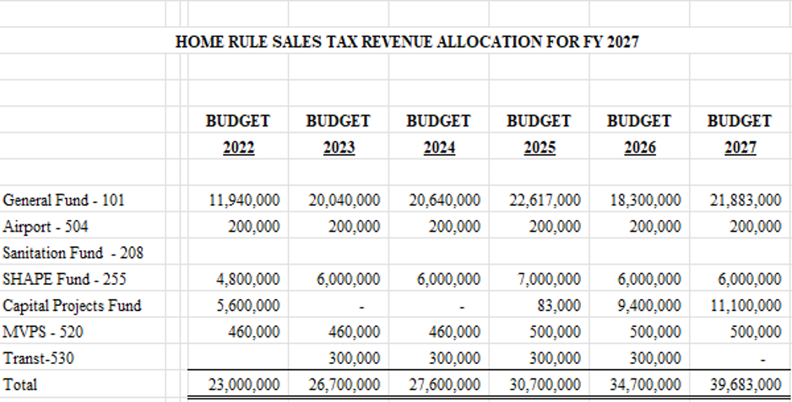
HOME RULE SALES TAX ALLOCATION

Slide 16
2027 FUNDING OF CAPITAL AND INTERNAL SERVICE FUNDS
FUNDING CAPITAL – HOME RULE SALES TAX $11.1M
FUNDING EMPLOYEE COMPENSATION FUND $3.8M
FUNDING EMPLOYEE HEALTH INSURANCE FUND $21.1M
FUNDING WORKER COMPENSATION PORTION $3.9M
FUNDING PROPERTY & CASUALTY PORTION $8.4M
FUNDING RETIREE HEALTH INSURANCE FUND $2.5

Slide 17
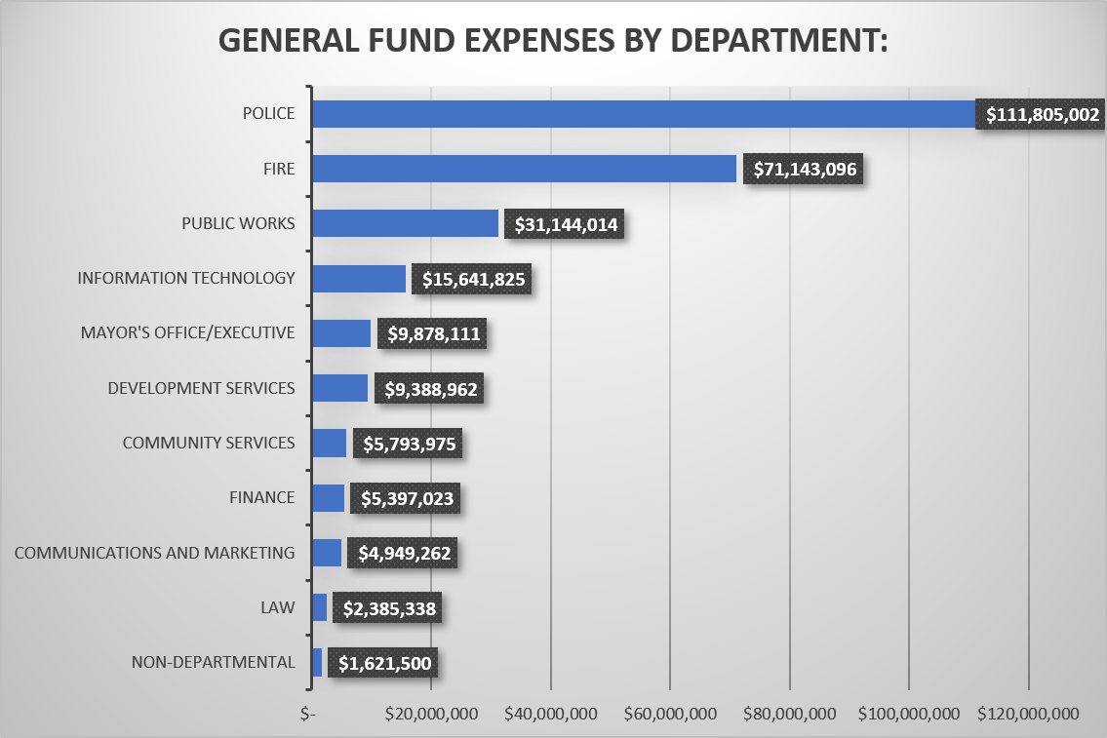

Slide 18
GENERAL FUND EXPENSES BY DEPARTMENT: |  |  |  |  | 2027 | 2026 | Percentage
Non-Departmental |  |  |  |  | $ 1,621,500 | $ 1,000,000 | 62.15%
Executive/Mayor's Office/City Clerk/Alderman/Human Resource/Sustainability/ Boards & Commissions |  |  |  |  | $ 9,878,111 | $ 9,245,766 | 6.84%
Law |  |  |  |  | $ 2,385,338 | $ 2,019,891 | 18.09%
Community Services |  |  |  |  | $ 5,793,975 | $ 6,494,958 | -10.79%
Information Technology |  |  |  |  | $ 15,641,825 | $ 15,203,507 | 2.88%
Communications and Marketing |  |  |  |  | $ 4,949,262 | $ 5,301,366 | -6.64%
Development Services |  |  |  |  | $ 9,388,962 | $ 9,664,909 | -2.86%
Finance |  |  |  |  | $ 5,397,023 | $ 4,767,777 | 13.20%
Fire |  |  |  |  | $ 71,143,096 | $ 65,996,122 | 7.80%
Police |  |  |  |  | $ 111,805,002 | $ 104,646,065 | 6.84%
Public Works and Facilities |  |  |  |  | $ 31,144,014 | $ 29,227,793 | 6.56%
Total General Fund |  |  |  |  | $ 269,148,108 | $ 253,568,154 | 6.14%

Slide 19
GAMING TAX FUND
INCREASED EACH WARD FUND ALLOCATION BY $10,000
TRANSFER $2.5M TO THE GENERAL FUND
TRANSFER $600,000 TO THE FIBER UTILITY FUND
TRANSFER FOR TIF DEBT SERVICE $634,700
ACCA $1.5M
PARKING DECK MAINTENANCE $2M
RENOVATE 649 RIVER (CEJA)
VARIOUS COMMUNITY SERVICES PROGRAMS
  QUALITY OF LIFE GRANTS
  WARMING SHELTER
  YOUTH PROGRAMS
  SENIOR & DISABILITY PROGRAMS
  POLICE SOCIAL SERVICES

Slide 20
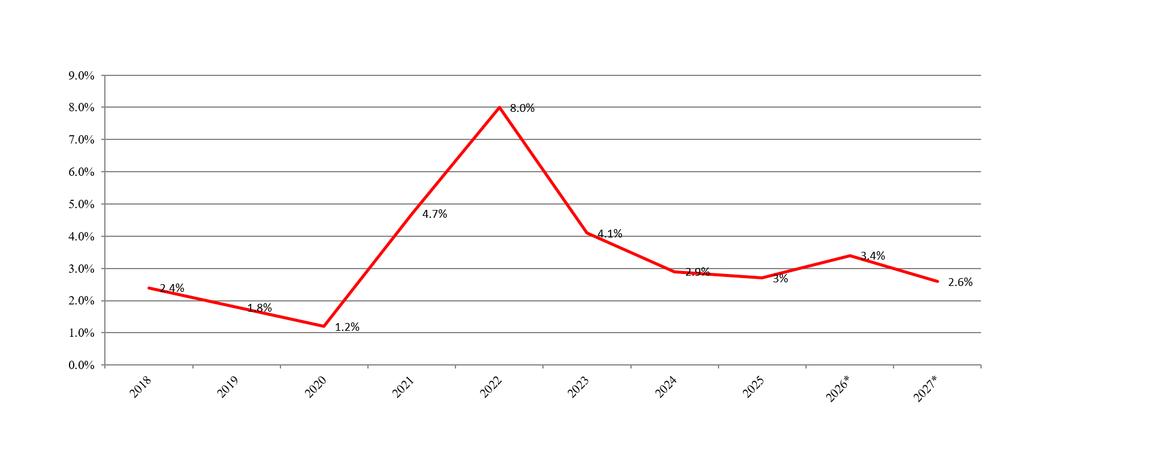
INFLATION
Notes:
Inflation
2018 2.4%
2019 1.8%
2020 1.2%
2021 4.7%
2022 8.0%
2023 4.1%
2024 2.9%
2025 3%
2026* 3.4%
2027* 2.6%

Slide 21
CAPITAL IMPROVEMENTS PLAN SUMMARY
CATEGORY | 2027 | 2028 | 2029 | 2030 | 2031-2036 | TOTAL
Downtown | $ 6,342,200 | $ 3,800,000 | $ 4,300,000 | $ 1,800,000 | $ 10,800,000 | $ 27,042,200
Downtown Riverwalk | $ 50,000 | $ 50,000 | $ 50,000 | $ 50,000 | $ 300,000 | $ 500,000
Facilities | $ 7,651,900 | $ 8,321,400 | $ 21,736,700 | $ 1,537,100 | $ 7,080,000 | $ 46,327,100
Airport | $ - | $ - | $ 4,900,000 | $ - | $ - | $ 4,900,000
Neighborhood Redevelopment | $ 1,000,000 | $ 1,050,000 | $ 1,100,000 | $ 1,150,000 | $ 7,950,000 | $ 12,250,000
Recreation | $ 815,000 | $ 2,760,000 | $ 3,335,000 | $ 90,000 | $ 150,000 | $ 7,150,000
Stormwater | $ 5,147,500 | $ 4,150,000 | $ 2,402,500 | $ 2,405,000 | $ 14,450,000 | $ 28,555,000
Transportation/Bridges | $ 2,610,000 | $ 2,670,000 | $ 970,000 | $ 1,030,000 | $ 54,340,000 | $ 61,620,000
Transportation/Streets | $ 20,600,600 | $ 26,450,800 | $ 21,520,000 | $ 23,397,500 | $ 242,710,000 | $ 334,678,900
Transportation/Traffic Signals | $ 12,994,000 | $ 11,648,000 | $ 5,795,000 | $ 1,365,000 | $ 8,940,000 | $ 40,742,000
Water & Sewer/Other | $ 3,891,700 | $ 1,486,000 | $ 5,252,150 | $ 1,980,000 | $ 5,250,000 | $ 17,859,850
Water & Sewer/Sanitary | $ 3,900,000 | $ 3,550,000 | $ 3,250,000 | $ 3,250,000 | $ 18,000,000 | $ 31,950,000
Water & Sewer/Watermains | $ 17,600,000 | $ 24,950,000 | $ 23,750,000 | $ 24,750,000 | $ 169,500,000 | $ 260,550,000
TOTAL ALL CATEGORIES | $ 82,602,900 | $ 90,886,200 | $ 98,361,350 | $ 62,804,600 | $ 539,470,000 | $ 874,125,050

Slide 22
2027 CAPITAL PRIORITIES CONTINUING
NEIGHBORHOOD STREET IMPROVEMENTS
LEAD SERVICE LINE REPLACEMENT
ORCHARD ROAD SOUND BARRIER
BROADWAY REDEVELOPMENT CORRIDOR
DOWNTOWN PARKING DECK RESTORATION
FIBER OPTIC EXPANSION ON THE EAST SIDE
NEW YORK STREET BRIDGE REHABILITATION

Slide 23
2027 DECISION PACKAGES
 | 2027
Decision Packages
Airport Fund | $ 100,000
Capital Improvements Fund | $ 2,443,200
Equipment Services Fund | $ 199,900
Federal Asset Forfeiture | $ 32,000
Gaming Tax Fund | $ 14,100
General Fund | $ 2,750,785
Golf Fund | $ 52,800
MVPS Maintenance | $ 52,300
SHAPE Fund | $ 107,652
Transit Centers | $ 734,250
Water & Sewer Fund | $ 1,902,300
TOTAL ALL FUNDS | $ 8,389,287

Slide 24
NEXT STEPS
20 Oct. – 19 Nov.
DEPARTMENTAL PRESENTATIONS
19 Nov. 2026
FINANCE COMMITTEE RECOMMENDATION
1 Dec. 2026
COMMITTEE OF THE WHOLE
8 Dec. 2026
PUBLIC HEARING AND CITY COUNCIL
15 Dec. 2026
TAX LEVY CONSIDERATION

