Slide 1
Aurora – Property License
Navigation and Information
Information and Step by Step instructions
on the Property License renewal process can be found here
https://www.aurora-il.org/2204/On-Line-License-Renewals
The web portal for License Renewal and Entry can be found here
https://auro-trk.aspgov.com/etrakit/

Slide 2
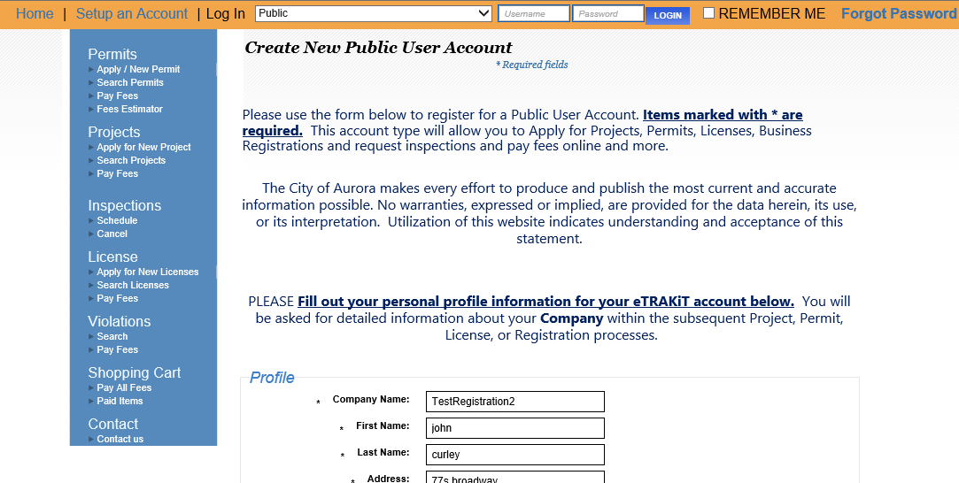
Aurora - Property License
Create a New Public User Account
https://auro-trk.aspgov.com/etrakit/
1a.
If you have not done so previously;
Select Set up an Account from the upper Orange Ribbon
1b.
If you previously have set up an account but can not recall your username and password; Please select FORGOT PASSWORD. A reset email will be sent to the email for the account. Should you not receive the reset email please call the office (630) 256-3770

Slide 3
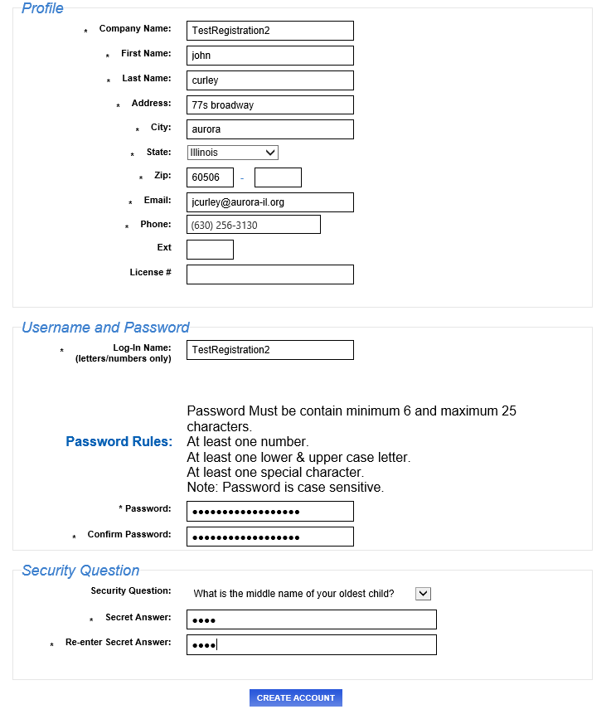
Aurora - Property License
Create a New Public User Account
2.
1.
Write your User Name and Password down for future reference
Enter the Required fields indicated by the leading Asterisk *

Slide 4
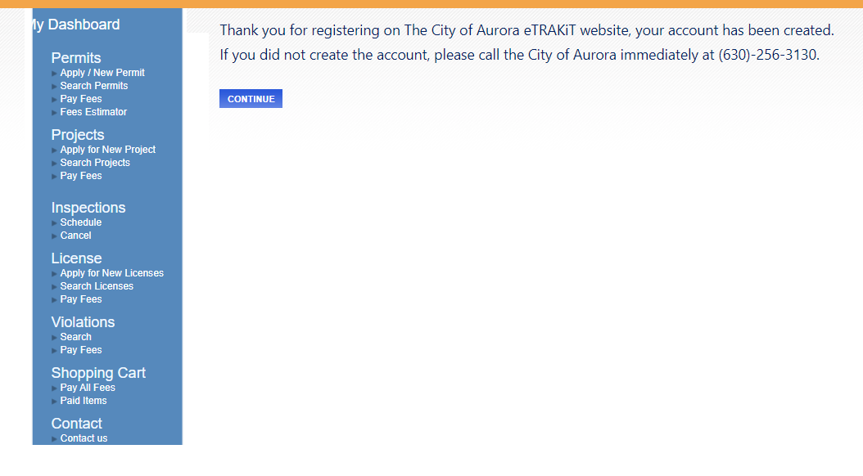
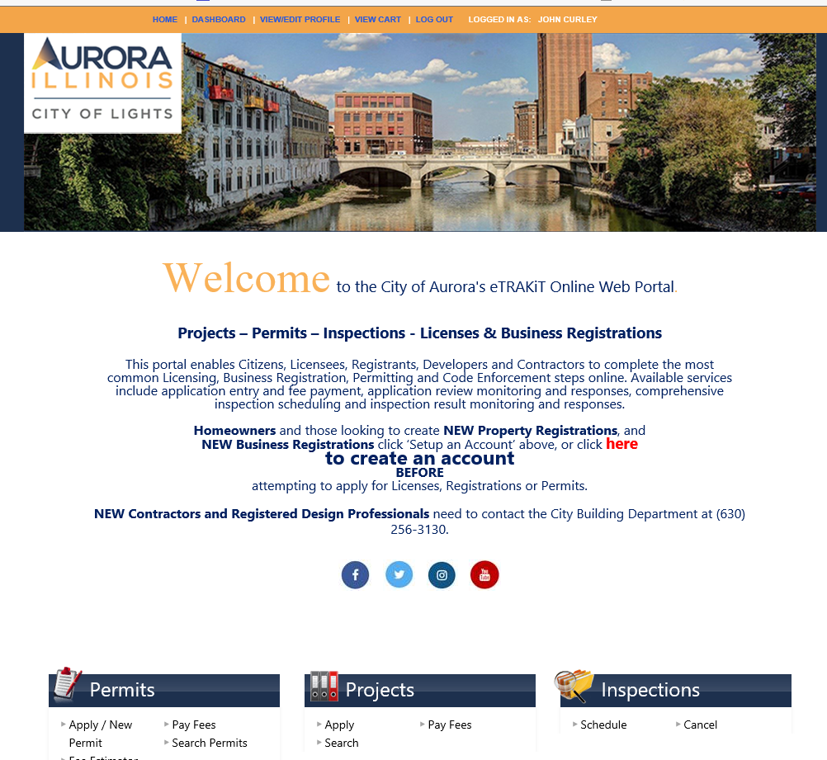
Aurora - Property License
Navigate to your account DASHBOARD
Click CONTINUE on the THANK YOU Screen
*********************************
NOW
Note that you are back at the Main Page
BUT you are logged in as yourself
*********************************
Click DASHBOARD to open your Dashboard
1.
2.
3.

Slide 5
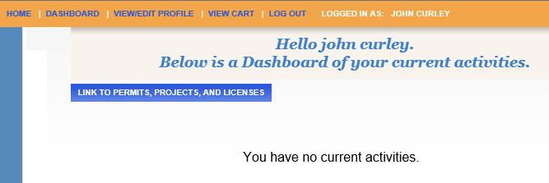

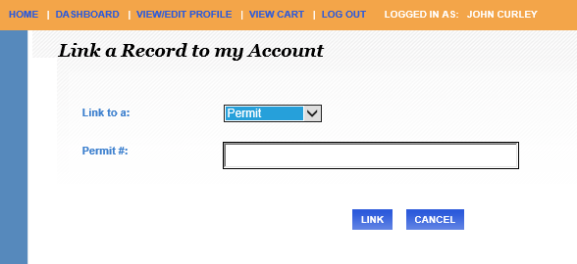

Aurora - Property License
Navigate to your account DASHBOARD
Click LINK to PERMITS, PROJECTS, and LICENSES on the Dashboard Screen
*********************************
NOW
Select the Down Arrow to the right of Permit to change this to License
*********************************
PASTE the license number portion of the the Subject line of your Renewal Email.
(e.g. RR1U2020-1*234
RR2U2020-1*234
VRSL2020-1*234
VCML2020-1*234 )
Make sure you delete any leading or trailing spaces after you PASTE.
*********************************
Select LINK.
1.
2.
3.
4.

Slide 6
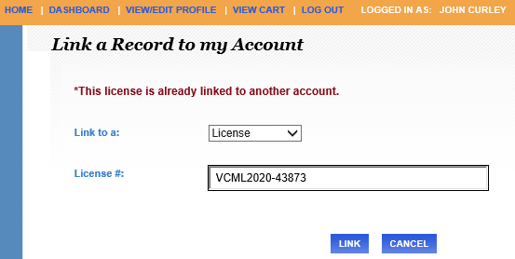
Aurora - Property License
Navigate to your account DASHBOARD
Should your get this Message you will need to contact our offices
(630) 256 -3770 or PSCS@aurora-il.org
*********************************
1.
2.
Should the System time-out on you please go back to your DASHBOARD to pickup from where you left off.

Slide 7
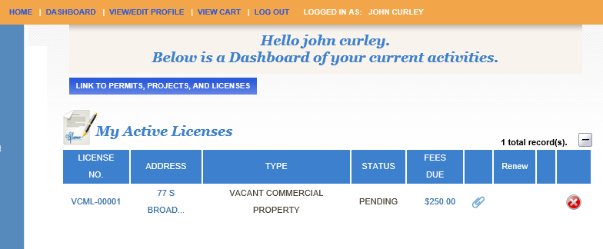
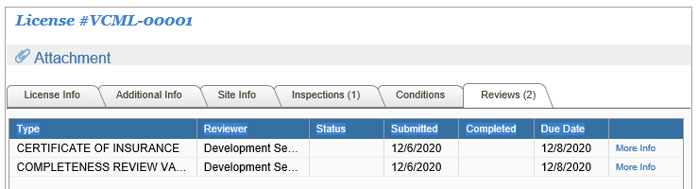
Aurora - Property License
Learning Your Account DASHBOARD
Your DASHBOARD will contain all records tied to your account.
Open License Applications (partially Completed applications)
Active Licenses
Active Permits
Licenses for Renewals
Active inspections
1.
2.
Click the License Number Hyperlink to review this records information. Click file tabs on the next screen.
3.

Slide 8
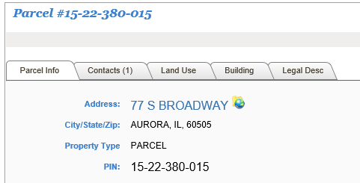
Aurora - Property License
Learning Your Account DASHBOARD
Your DASHBOARD will contain all records tied to your account.
Open License Applications (partially Completed applications)
Active Licenses
Active Permits
Licenses for Renewals
Active inspections
1.
2.
Click the Land Record Hyperlink to review this records Land Related information. Click file tabs on the next screen.
3.

Slide 9
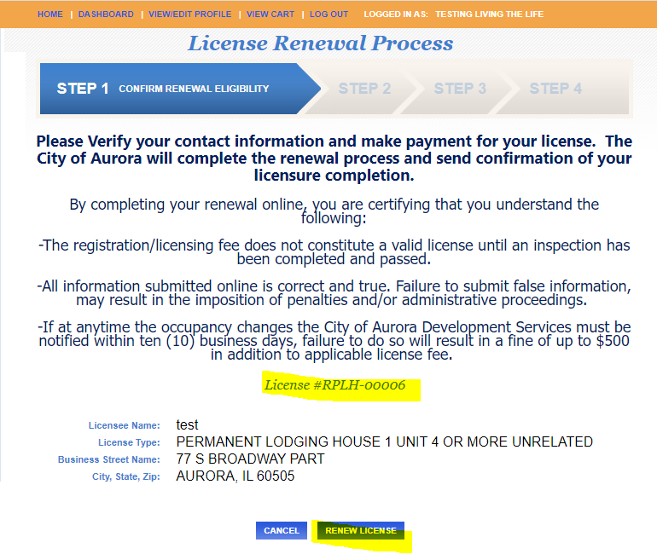
Aurora - Property License
RENEWING License
Your DASHBOARD will contain all records tied to your account.
Open License Applications (partially Completed applications)
Active Licenses
Active Permits
Licenses for Renewals
Active inspections
1.
2.
Click RENEW SYMBOL to renew,
Hit Renew License next screen
3.

Slide 10
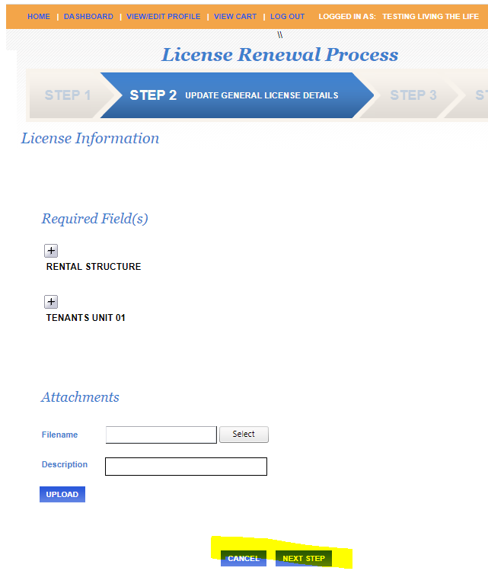
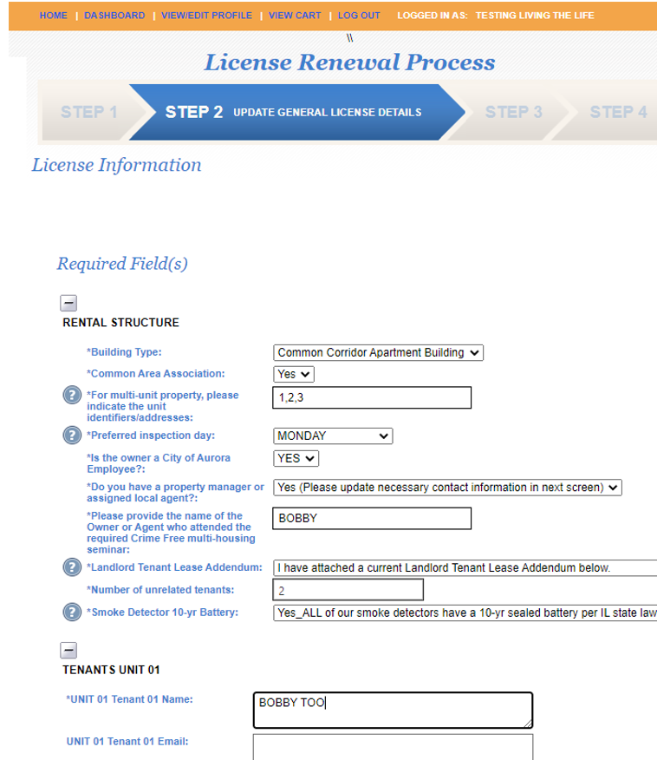
Aurora - Property License
Updating License Data
2a. Fill in or Review the requested data fields. (Note that the Required fields start with an *)
2b.If the data field has an down arrow on the right side of the data box click that and select the most appropriate choice.
Hover or click on the ? Mark for assistance or additional information
2c. Don’t forget the tenant Data as well
1. Click on the + signs to expand the Required fields
1.
2a.
2b.
1.
3. Add any attachments (e.g. Lease Addendum updates.
3a.
2c.
3b. upload
4. Next Step

Slide 11
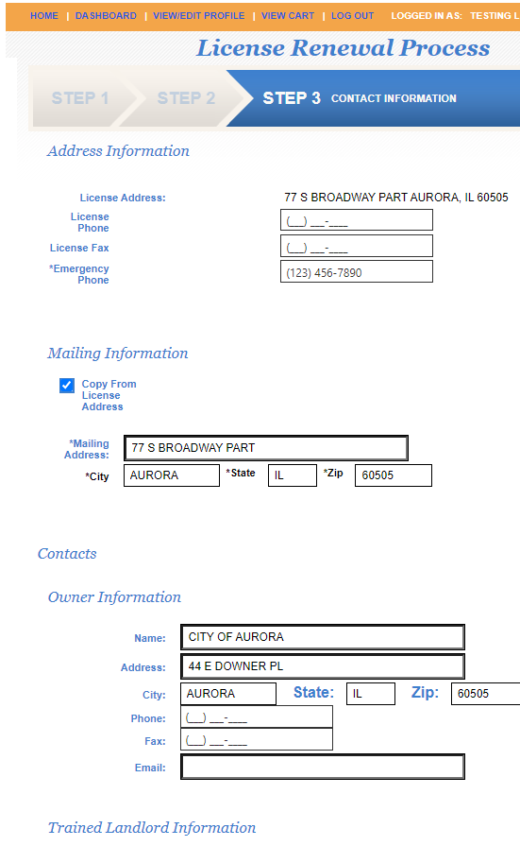
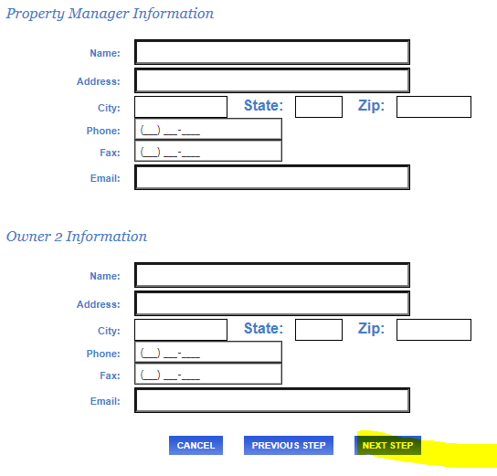
Aurora - Property License
Updating Contact Information
Update Licensee phone information (Note: the * represents a required field)
Update the Mailing information (click copy from licensee address if the same)
Update the contacts Information if required.
Click NEXT STEP when complete
1.
2.
3.
4.

Slide 12
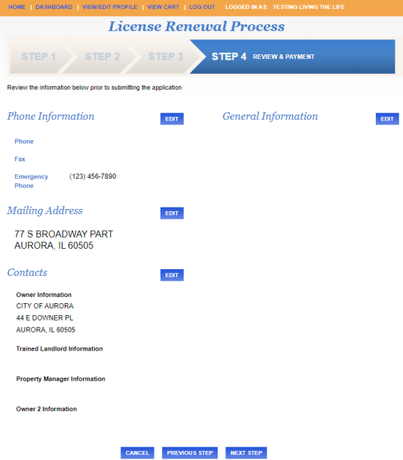
Aurora - Property License
Review Updated information
1.
Verify that all of the information is correct
If needed EDIT information using the EDIT button
Click NEXT STEP when complete
2.
3.

Slide 13
Aurora - Property License
Review Updated information
Verify that all of the information is correct
If needed EDIT information using the EDIT button
Click NEXT STEP when complete
1.
4. The Next Screen takes you to a payment screen. Complete the payment if a balance is due and print your confirmation screen if desired.
2.
5. If your license requires an interior inspection this year, you will receive an email confirming the inspection at a later date. If your license only requires an exterior inspection, we will perform those without appointment. Please make sure your emails are correct in your contact information to receive inspection confirmations and inspection results. Please reach out to the inspector if this inspection will not be able to be performed with at least 48 hours notice.
THANK YOU !
3.

